Slide 1
Capstone Engagement
Assessment, Analysis, and Hardening of a Vulnerable System

Slide 2
Table of Contents
This document contains the following sections:
01
Network Topology
02
Red Team: Security Assessment
03
Blue Team: Log Analysis and Attack Characterization
Hardening: Proposed Alarms and Mitigation Strategies
04

Slide 3
Network Topology
‹#›

Slide 4
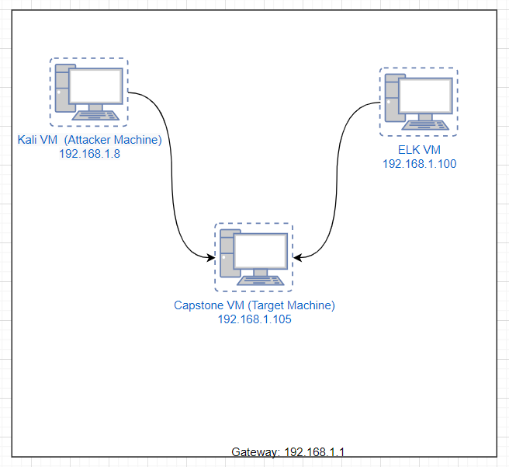
Network Topology
Network
Address Range: 192.168.1.0 - 192.168.1.255
Netmask:255.255.255.0
Gateway: 192.168.1.1
Machines
IPv4: 192.168.1.100
OS:Linux
Hostname: ELK VM
IPv4: 192.168.1.105
OS:Linux
Hostname: Capstone VM
IPv4: 192.168.1.8
OS:Kali Linux
Hostname: Kali VM

Slide 5

Red Team
Security Assessment
‹#›

Slide 6
Recon: Describing the Target
Nmap identified the following hosts on the network:
Hostname | IP Address | Role on Network
Capstone VM (server1) | 192.168.1.105 | Target Machine
Kali | 192.168.1.8 | Attacking Machine
ELK | 192.168.1.100 | Hosts all Kibana data.
Azure (LocalVM) | 192.168.1.1 | Hosts the Red v Blue VM.

Slide 7
Vulnerability Assessment
The assessment uncovered the following critical vulnerabilities in the target:
Vulnerability | Description | Impact
Unprotected sensitive data. | Finding a “secret” folder containing sensitive information while being located on a public facing server. | Finding this directory allows the attacker to discover enough information that will lead to find user credentials
Unauthorized file upload privilege. | Uploaded a file. | Allowed us to remote access via the reverse shell connection..
Reverse shell access | Allows the attacker to execute a command on the target machine. | The attacker is able to extract sensitive data; compromise the machine; act as the authorized user.

Slide 8
Exploitation: Unprotected Sensitive Data
01
02
03
Tools & Processes
First, I ran an Nmap scan against the network (CIDR Notation- 192.168.1.0/24).
Secondly, entered the IP address of the target machine (192.168.1.105).
From here, I discovered a list of directories. Next, I opened each directory to reveal the contents until I arrived at an area that should otherwise be protected from public access.
Achievements
Discovered a “secret” folder” which required credentials.
Subjected this directory to a brute force attempt and successfully located the password tied to the user so that further access could be granted.
Discovered a second set of user credentials which allowed for the
See next slide: Screenshot provided.

Slide 9
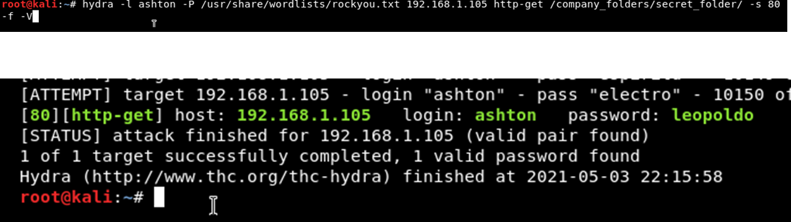
03

Slide 10
Exploitation: Unauthorized File Upload privilege.
01
02
03
Tools & Processes
Now equipped with Ryan’s credentials, I was able to access the webdav folder and upload the payload file using msfvenom.
Achievements
By uploading this payload file, it allowed for a netcat listener to be established which in turn allows for me [the attacker] to execute commands on the target machine.
See next slide: Screenshot provided.

Slide 11
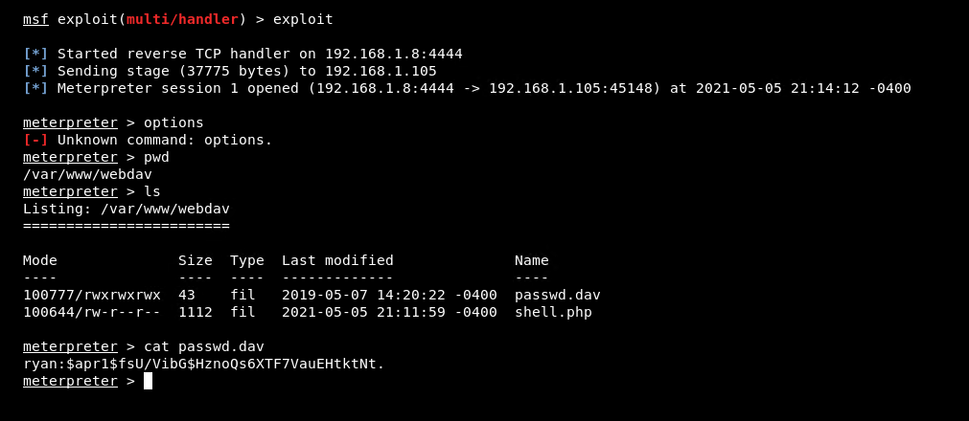
03

Slide 12
Exploitation: Reverse shell access
01
02
03
Tools & Processes
Used meterpreter to explore and compromise the entire system.
Achievements
Was able to compromise the system using arbitrary commands to gain possession of sensitive data, in this case--a flag.
See next slide. Screenshot provided.

Slide 13
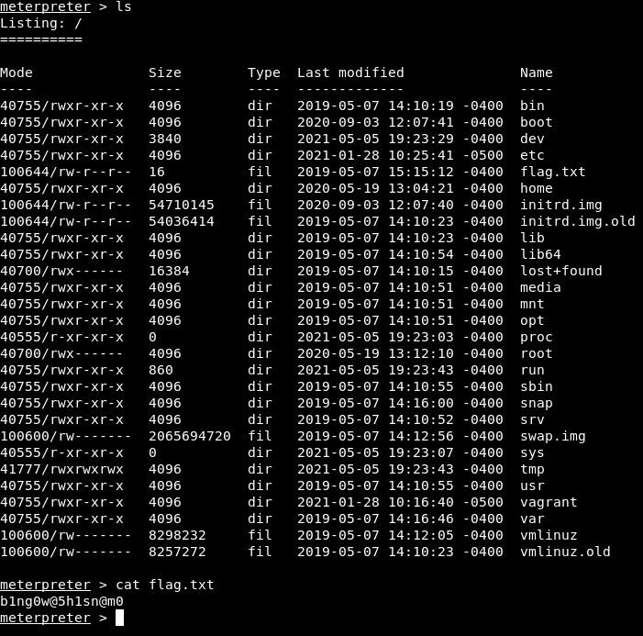
03

Slide 14

Blue Team
Log Analysis and Attack Characterization
‹#›

Slide 15
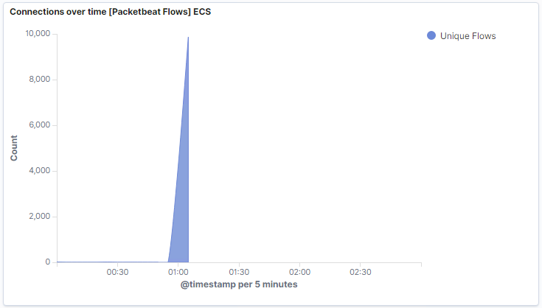
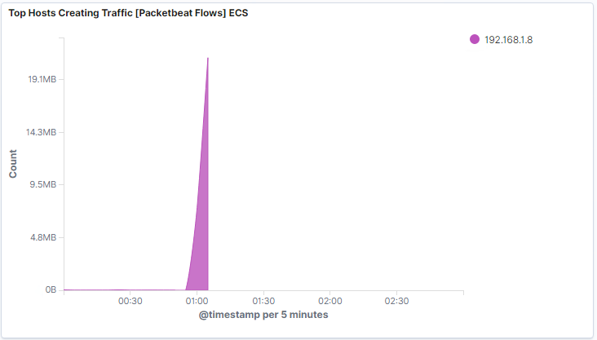
Analysis: Identifying the Port Scan
At the 1:05 mark we can observe spikes in activity and how it directly correlates to the IP Address: 192.168.1.8 (Attacker Machine).

Slide 16
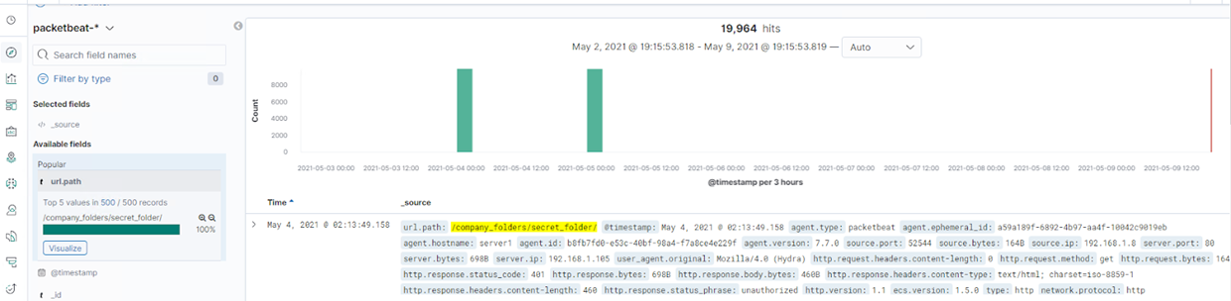
Analysis: Finding the Request for the Hidden Directory
See additional slide next

Slide 17
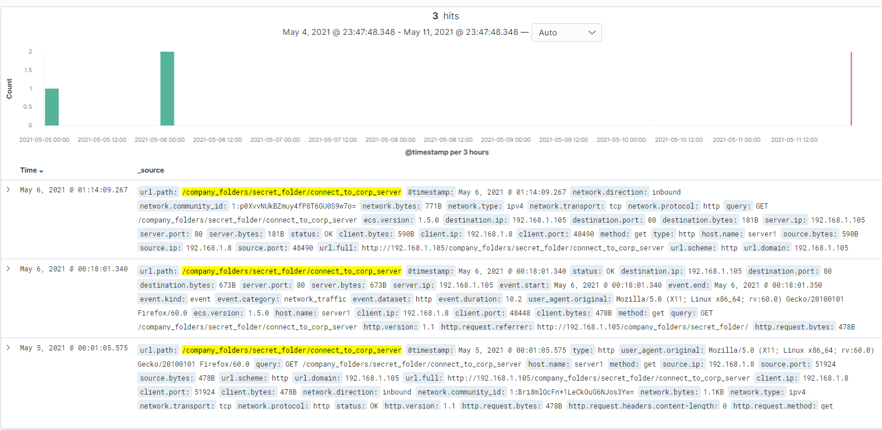
Analysis: Finding the Request for the Hidden Directory

Slide 18
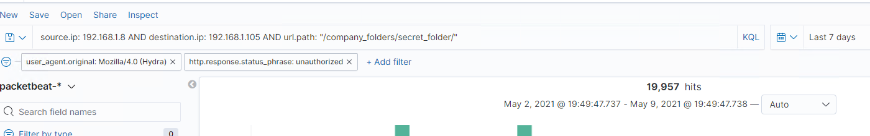
Analysis: Uncovering the Brute Force Attack

Slide 19
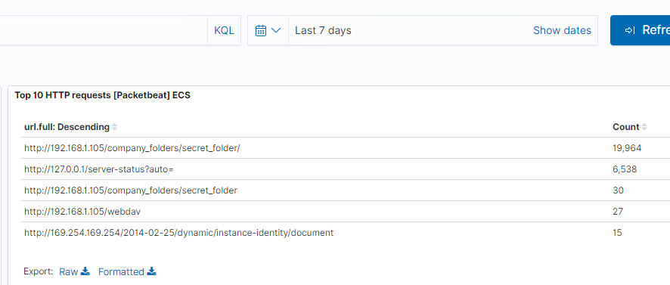
Analysis: Finding the WebDAV Connection

Slide 20
Blue Team
Proposed Alarms and Mitigation Strategies
‹#›

Slide 21
Mitigation: Blocking the Port Scan
What kind of alarm can be set to detect future port scans?
Set alarm for when a single IP is sending an (x)amount of packets/per 1 minute intervals..
What threshold would you set to activate this alarm? 1000 packets per 1 minute interval.
What configurations can be set on the host to mitigate port scans?
Implement a IPS/IDS tool
Firewall

Slide 22
Mitigation: Finding the Request for the Hidden Directory
What kind of alarm can be set to detect future unauthorized access?
I would set 2 separate alerts. The first would be at a Low-Normal priority for whenever someone accesses the company_folders directory. Then I would set a secondary alert with a priority of High for whenever someone attempts to interact or access the secret_folder directory.
What threshold would you set to activate this alarm? I would set a limit (threshold) triggered after 3 events.
What configuration can be set on the host to block unwanted access?
Reconfigure to store the secret folder on a private facing network.
Add file folder encryption or encrypt the data within the folder.

Slide 23
Mitigation: Preventing Brute Force Attacks
What kind of alarm can be set to detect future brute force attacks?
Set an alarm for a designated number of unsuccessful attempts reached.
What threshold would you set to activate this alarm?
A threshold could be set at 3 attempts per second.
What configuration can be set on the host to block brute force attacks?
Limit the number of user attempts.

Slide 24
Mitigation: Detecting the WebDAV Connection
What kind of alarm can be set to detect future access to this directory?
Set an alarm for any unauthorized wireless access to the webdav; set an alarm for unauthorized access attempts occurring outside of the organization.
What threshold would you set to activate this alarm?
I would set a threshold of 3 attempts per alarm per the above alarm designations.
What configuration can be set on the host to control access?
Putting into place a firewall if it does not exist or if it is currently in place, evaluate the current configurations and reconfigure to provide stronger protection.

Slide 25
Mitigation: Identifying Reverse Shell Uploads
What kind of alarm can be set to detect future file uploads?
Set an alarm for any traffic going out of the target machine on port 4444.
What threshold would you set to activate this alarm?
For this particular alarm, I would implement what I would call a “zero-tolerance” alarm in the the interim, evaluate and reconfigure at post evaluation.
What configuration can be set on the host to block file uploads?
Block traffic inbound and outbound on port 4444 with the use of a firewall.

